Slide 1


Hybris layers
Jalo, Service layer, Service layer direct
September 7, 2017

Slide 2
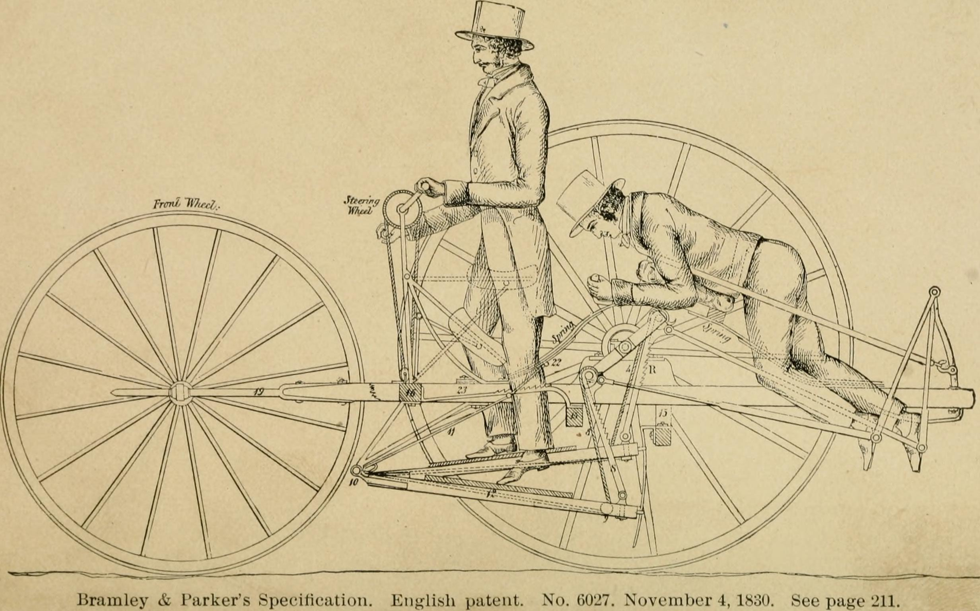
What all this is about?
Notes:
A little bit of history
Jalo coming first, then comes service layer

Slide 3
Who is who
Jalo
The Jalo Layer is the traditional SAP Hybris Commerce functional layer. It combines both data model and business logic aspects. "Jalo" is short for Jakarta Logic, the original name of the Hybris Platform. Jalo is now deprecated. ( for how many years, I wonder… )
ServiceLayer
The Hybris ServiceLayer is an API for developing services for SAP Hybris Commerce. It provides a number of common services, while allowing you to extend these or develop your own. It provides a clean separation of business logic and persistence logic.
ServiceLayer Direct
The ServiceLayer Direct feature is an alternative implementation of persistence operations in the SAP Hybris Commerce framework. ServiceLayer Direct allows you to read and write data from the database and completely skip the old Jalo layer. From the user perspective nothing has changed and ModelService is used as usual for managing models.

Slide 4
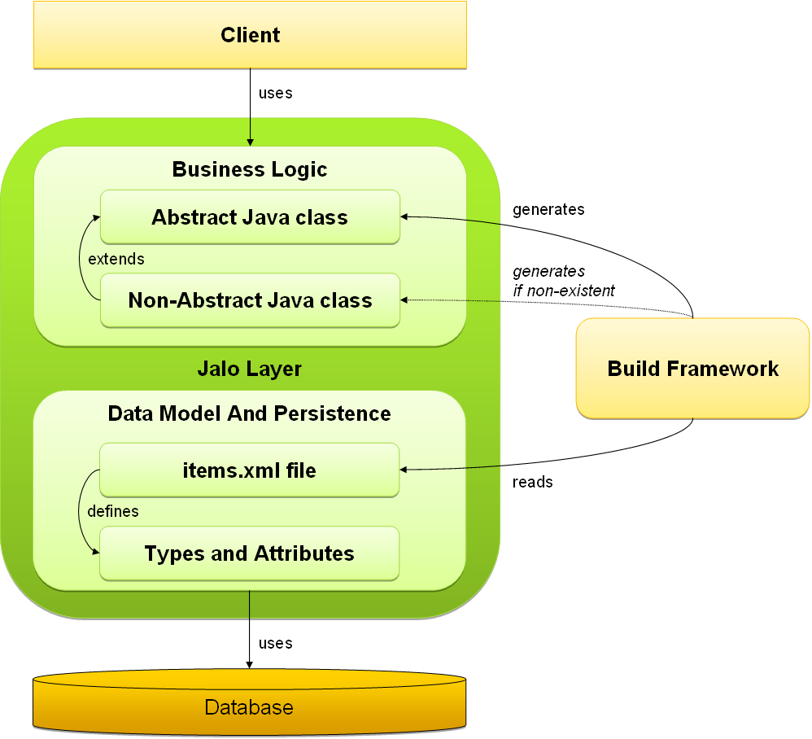
Jalo - Architecture
Data Model, which you can define in the items.xml files in the form of types and attributes.
Business Logic, which you implement in Java classes.
Jalo-only Attributes – implementing logics in manager class when extending existing class ☺

Slide 5
Jalo – Item CRUD
Jalo – Item CRUD
Create
ComposedType.newInstance()
Read
GeneratedProduct.getCode() – direct DB call
Write
GeneratedProduct.setCode() – direct DB call
Delete
GeneratedProduct.remove()

Slide 6
Jalo – JaloSession
Every thread has one (as a thread-local variable), created on first get
Non-persistent, yet serializable
Holds all session-specific info (user, currency, language, timezone etc.)
Subtype can be created via spring bean “jalosession”, which will be used then (btw, there is 99% chance you use CommerceJaloSession, not a pure one ☺)
When contained inside http session - lives and dies together with it (default.session.timeout=3600)
Partially wrapped by SessionService, accessed from various services

Slide 7
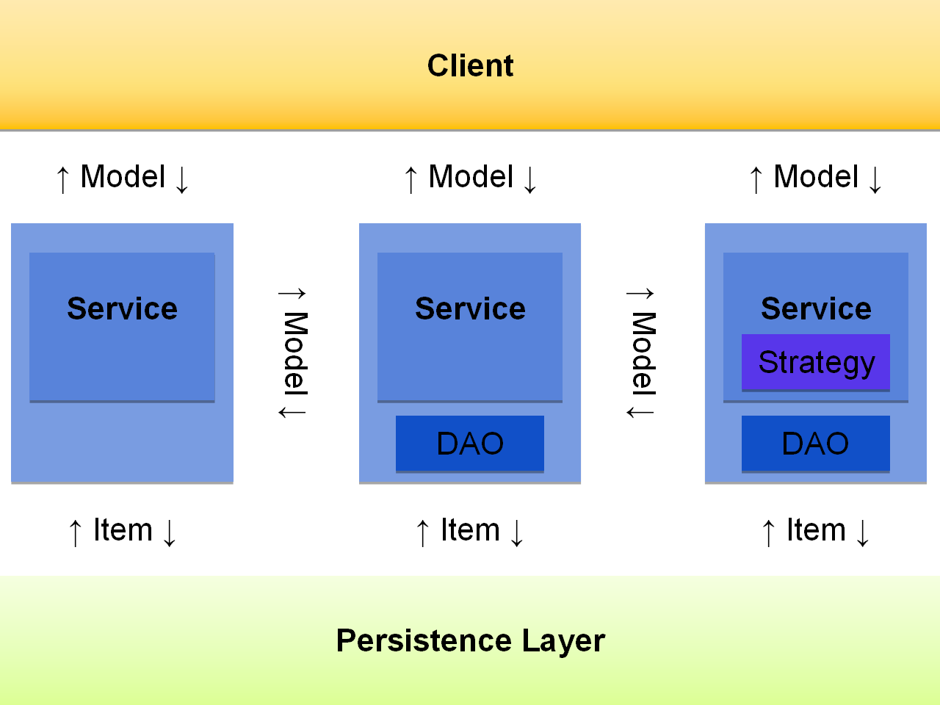
Service Layer - Architecture
Allows abstraction from persistence layer
Based on services architecture
Loose coupling
Spring!
Works with POJO models
Easy-to-mock

Slide 8
Service Layer – ItemModel CRUD
Create
First way
ProductModel productModel = new ProductModel()
modelService.initDefaults(productModel)
modelService.attach(productModel)
modelService.save(productModel)
True way
modelService.create(ProductModel.class)
modelService.save(productModel)
Read
ProductModel.getCode()… => GeneratedProduct.getCode() ☹
Write
ProductModel.setCode() – no DB operation
modelService.save(productModel)
Delete
modelService.remove(productModel)
Notes:
private Constructor<? extends AbstractItemModel> getModelConstructorForContext() { if (this.modelClassConstructor == null) { try { this.modelClassConstructor = this.modelClass.getDeclaredConstructor(MODEL_CONSTR_SIG); if (!this.modelClassConstructor.isAccessible()) { this.modelClassConstructor.setAccessible(true); } } catch (NoSuchMethodException var2) { throw new ModelCreationException("Error while creating new instance of model type " + this.modelClass.getName(), var2); } } return this.modelClassConstructor; }

Slide 9
Jalo Layer VS Service layer – Manager #1
Jalo - ExtensionManager/Extension classes:
Were used to make actions on system startup/before system init/shutdown based on class creation/destroy
Create essential data/create project data
Service layer - replaced by:
System init/update, project/essential data creation hooks - @SystemSetup annotation & Patch framework

Slide 10
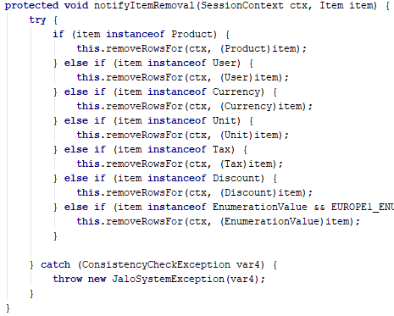
Jalo Layer VS Service layer – Manager #2
Jalo – Manager (parent for all Extension managers and …)
Checks before/after item creation/removal
Item removal notifications
System initialization end actions
Service layer - replaced by:
Prepare/Remove interceptors
After item creation/removal events
After init start/end events
… PriceFactory! O_0

Slide 11

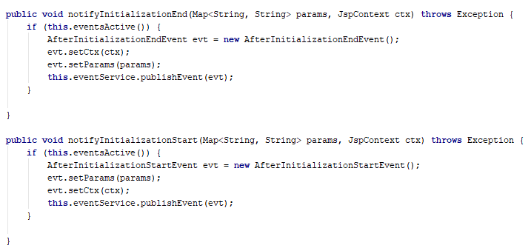

Jalo Layer VS Service layer – Manager #3
ServicelayerManager – WTF???

Slide 12
Jalo Layer VS Service layer – Constants
Jalo - GeneratedXXXConstants
Constants.TC.* (Typecode)
CategoryConstants.Attributes.Media.SUPERCATEGORIES
CategoryConstants.Relations.CATEGORYPRODUCTRELATION
GeneratedDentsplyConstants.EXTENSIONNAME
Service layer - replaced by:
ItemModel._TYPECODE
CategoryModel.SUPERCATEGORIES
ProductModel._CATEGORYPRODUCTRELATION
DentsplyConstants.EXTENSIONNAME

Slide 13
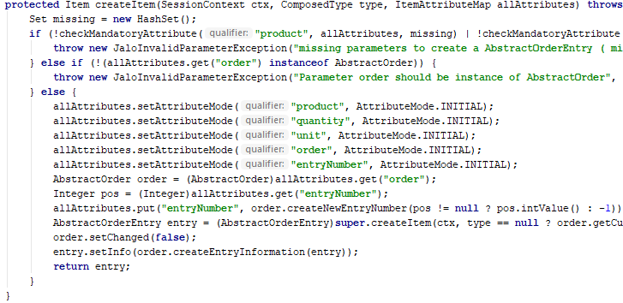

Jalo Layer VS Service layer – Item class
Jalo
You can create/remove item
Add a whole lot of business logic to make things funnier
Service layer
You need to use modelService for this
You need to create your own services and strategies

Slide 14
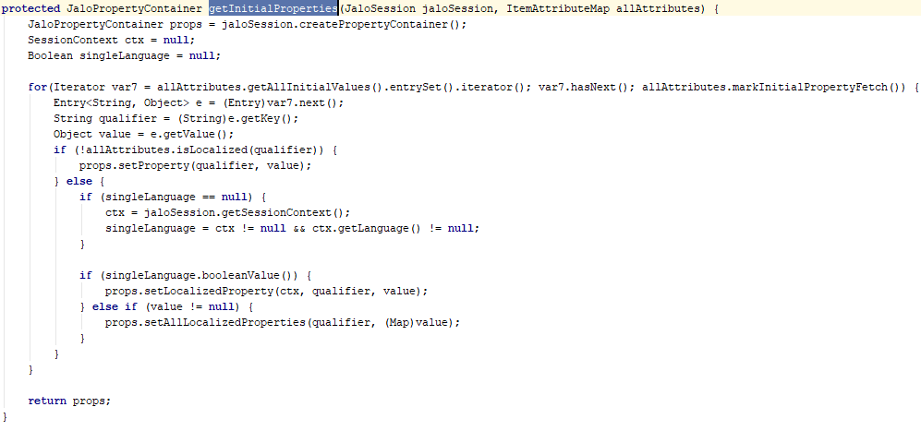
Jalo Layer VS Service layer – Item class(bonus)
Have you ever though about Initial attribute setting with write=false? How can it set anything? Oh wait….

Slide 15
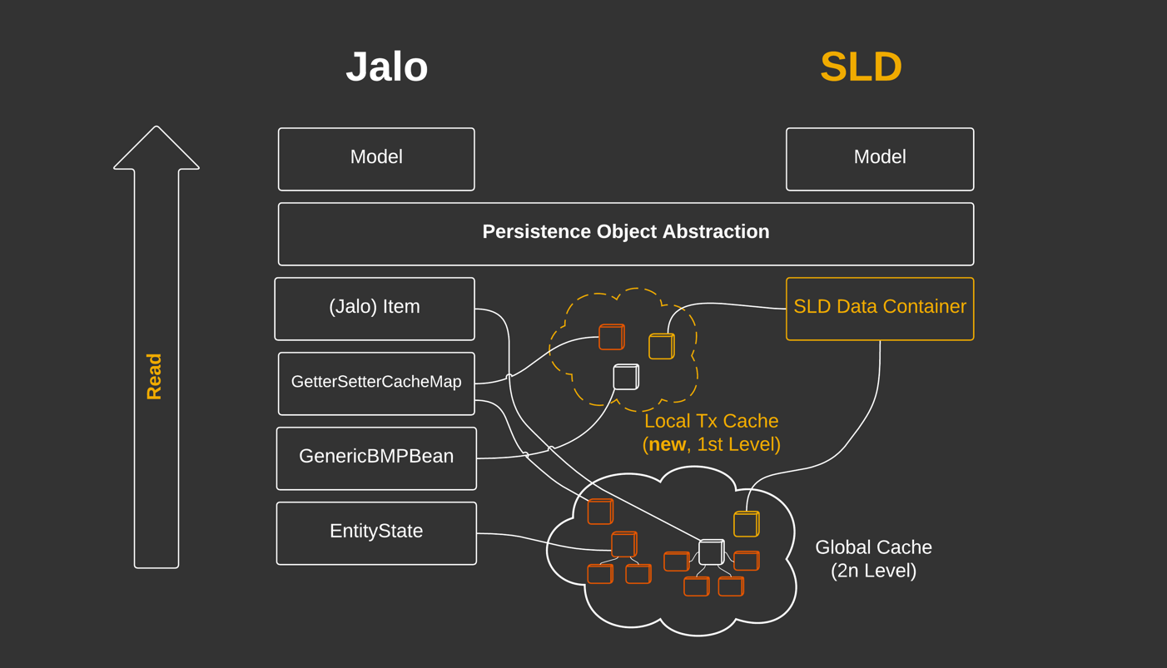
Service Layer Direct – Architecture #1

Slide 16
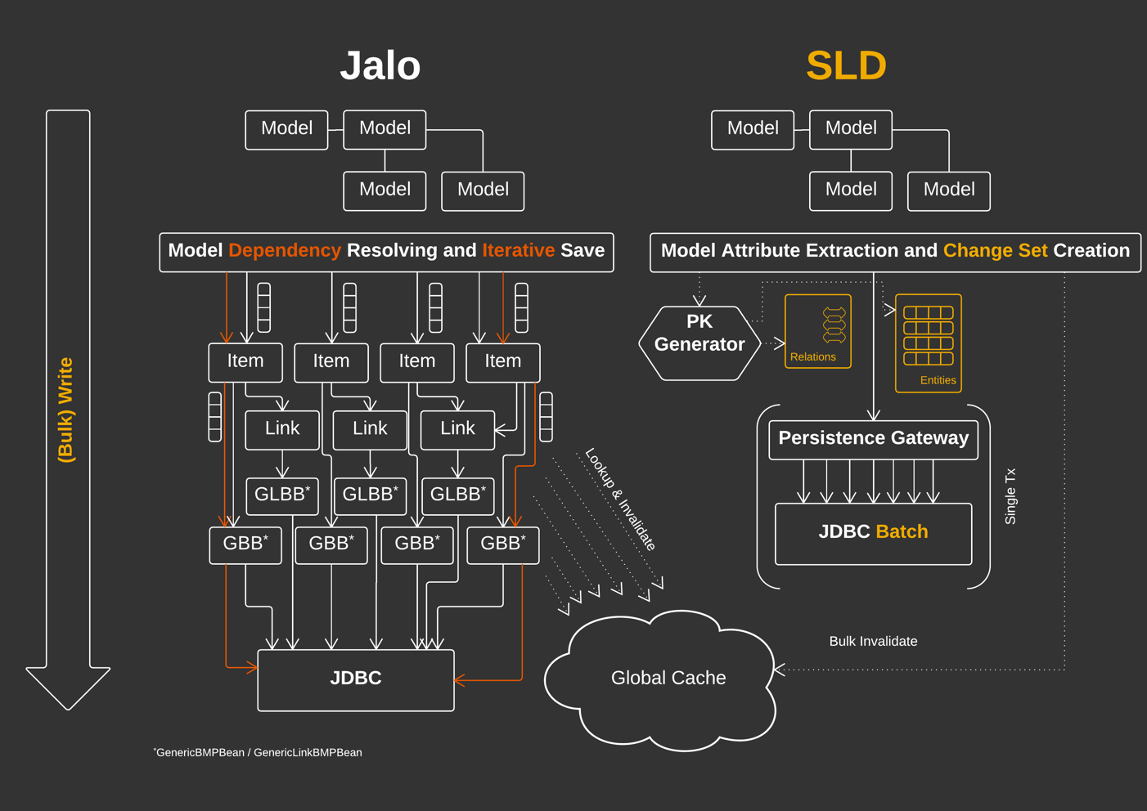
Service Layer Direct – Architecture #2

Slide 17
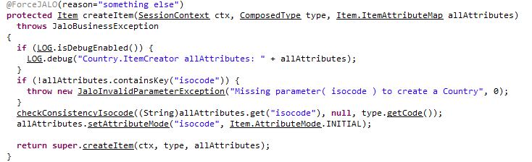
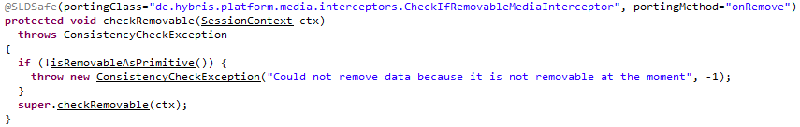
Service Layer Direct – @ForceJalo & @SLDSafe
If persistence.legacy.mode=false - SLD will work by default, with one BUT – only when all related items are SLDSafe

Slide 18
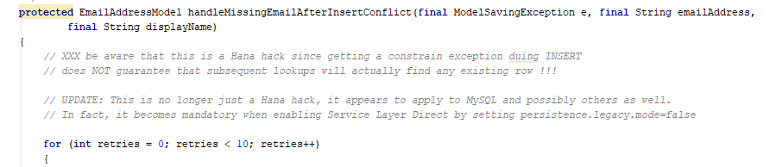
Service Layer Direct – platform evolution!
Service Layer Direct – platform evolution!

Slide 19
Rough performance test
Stocks records creations with productCode, warehouse and availability filled (coming later)
Type/Number of records | 10000 | 100000
Jalo
Jalo (setting availability after creation)
Service layer (saveAll)
Service layer (save)
SLD (saveAll)
SLD (save)

Slide 20
Related links & materials used
Transitioning to the ServiceLayer https://help.hybris.com/6.5.0/hcd/8c73dbae866910148f6889b98a54e067.html
Jalo layer https://help.hybris.com/6.5.0/hcd/8c00066686691014a5a5d19875a1525b.html
JaloSession https://help.hybris.com/6.5.0/hcd/8c005cde86691014a49ce1de22f3897f.html
Service Layer https://help.hybris.com/6.5.0/hcd/8c5a6a5986691014a65ee480c04c7b28.html
Models https://help.hybris.com/6.5.0/hcd/8c146aa686691014bbf6fe76a708ece2.html
Service Layer Direct https://help.hybris.com/6.5.0/hcd/d4dc444c9cbb46f78c78ff3d8a26539b.html

Slide 21
THE END
Questions?

